Slide 1
National Council of University Research Administrators Annual Meeting
August 2014

Slide 2
The National Institute of Food and Agriculture
The National Institute of Food and Agriculture (NIFA) is an agency within the U.S. Department of Agriculture (USDA). Congress created NIFA through the Food, Conservation, and Energy Act of 2008. NIFA replaced the former Cooperative State Research, Education, and Extension Service (CSREES), which had been in existence since 1994.
NIFA is one of four USDA agencies that make up its Research, Education, and Economics (REE) mission area.

Slide 3
The National Institute of Food and Agriculture
NIFA's mission is to lead food and agricultural sciences to create a better future for the Nation and the world by supporting research, education, and extension programs in the Land-Grant University System and other partner organizations.
NIFA doesn't perform actual research, education, and extension but rather helps fund it at the state and local level and provides program leadership in these areas. The broad expectation is that NIFA will enhance the stature and impact of food, agricultural, and natural resource sciences and ultimately grow support for agricultural research, education, and extension.

Slide 4
The National Institute of Food and Agriculture
National Program Leadership
Help states identify and meet research, extension, and education priorities in areas of public concern that affect agricultural producers, small business owners, youth and families, and others
Extensive network of state, regional, and county extension offices in every U.S. state and territory
Federal Assistance
Administer capacity grants to land-grant universities and
Administer competitively granted funds to researchers in land-grant and other universities

Slide 6
The Office of Grants and Financial Management
Policy and Oversight Division (POD)
Develops regulations, policies, and procedures that are related to federal financial assistance and performs administrative/financial reviews, audit resolution, and compliance-related activities.
Awards Management Division (AMD)
Develops, executes, and administers cooperative agreements and grants.
Financial Operations Division (FOD)
Authorizes all new payments to grantees, maintains official accounting records, and oversees financial reporting.

Slide 7
Major Provisions of the Agricultural Act of 2014 (“Farm Bill”)
New matching requirement for some competitive grant programs
Non-Land Grant Colleges of Agriculture formal certification process
Centers of Excellence
Reauthorized and new mandatory programs (e.g., Specialty Crop Research Initiative…)

Slide 8
Types of NIFA Awards
Grant (competitive, non-competitive, capacity)
Transfers money, property, services, or anything of value to the recipient in order to accomplish a public purpose of support or stimulation
Supplemental
Adds funds to an initial award to ensure adequate completion of the original scope of work
Renewal
Extends time and money on an existing award
Continuation
Project Director (PD) Transfer
Revision
Cooperative Agreement
Provides a specific level of support over a specific period of time, (usually in annual increments)
Moves an award from one institution to another
Revises an existing award for various reasons
Includes substantial involvement on the part of the funding agency

Slide 9
Sources of NIFA Policy
Congressional Requirements
Program legislation
Appropriations
Executive Branch Requirements
OMB Circulars/Uniform Guidance*
Executive Orders
USDA Requirements
USDA regulations
USDA policy
NIFA Requirements
Regulations
(7 CFR 3000)
NIFA Policy Guide (forthcoming)
Program guidance
Terms & Conditions

Slide 10
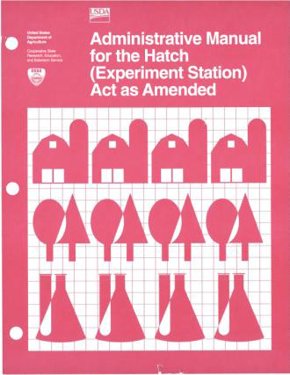
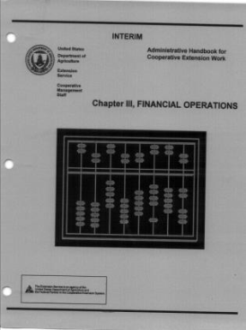
Federal Assistance Policy Guide (“NIFA Policy Guide”)
Single, comprehensive guidance document for NIFA grantees and staff
Provides guidance for competitive and capacity grants
Based on laws, regulations, USDA guidance, NIFA guidance, NIFA policy, and Administrative Manuals applicable to NIFA grants, cooperative agreements, endowments, and other financial assistance
Updates and replaces former Administrative Manuals (identified below)

Slide 11
USDA Regulatory Changes
2 CFR Part 400 (adopts 2 CFR part 200)
2 CFR Part 415 – General Prog Admin Regs
2 CFR Part 416 – State and Local Govts
2 CFR Part 418 – Lobbying
2 CFR Part 422 – Research Misconduct

Slide 12
USDA Regulatory Changes
2 CFR part 400 series supersedes
7 CFR Part 3015
7 CFR Part 3016
7 CFR Part 3018
7 CFR Part 3019
7 CFR Part 3022
7 CFR Part 3052
Update references in NIFA regulations

Slide 13
NIFA Competitive Grant Process
Request for Application (RFA) posted on Grants.gov and agency website
NIFA receives applications
Peer Review conducted by external panel
NIFA selects awardees and announces awards
NIFA obligates funds and authorizes disbursement through ASAP
Conduct project
Post Award Management (reporting and oversight)
Closeout

Slide 14
Request for Application (RFA)
Recently released RFAs and RFAs with an approaching deadline
There is a link on the NIFA home page (www.NIFA.usda.gov) to a listing of RFAs meeting this description.
Request for Application anticipated to be released in near term
National Robotics Initiative (NRI)
Supported by multiple agencies of the federal government including the National Science Foundation (NSF), the National Aeronautics and Space Administration (NASA), the National Institutes of Health (NIH), the U.S. Department of Agriculture (USDA), and the U.S. Department of Defense (DOD).
NSF publishes
AFRI - NIFA Fellowships
Biomass Research Development Initiative (BRDI)
Food Insecurity Nutrition Incentive

Slide 15
Financial Reporting in REEport
AD – 419, “Funding and Staff Support” from CRIS will be called “REEport Project Financial Report” in REEport
Allows NIFA to report to Congress and stakeholders more comprehensively at the project level on funds that support and are leveraged in specific subject areas.
Actual data fields are the same
Functionality is different
Training: Online documentation and webinars (go to http://www.csrees.usda.gov/about/strat_plan_web.html to sign up for webinar email notifications)

Slide 16
Financial Reporting in REEport
All FY14 Capacity projects are to use REEport
due by Feb 1, 2015
Non-Capacity Projects is being reinstated (official Memo to be released soon)
This requirement will only apply to awards made beginning October 1, 2014 (modified award terms and conditions will be included in new awards and awards receiving an increment of funding).
REEport Contact - Katelyn Sellers at ksellers@nifa.usda.gov

Slide 17
Contact Information Office of Grants and Financial Management
Maria Koszalka
Policy & Oversight Division Director
Lisa Scott-Morring
Policy Branch Chief,
Policy & Oversight Division
Melanie Krizmanich
Senior Policy Specialist,
Policy & Oversight Division
Maria.Koszalka@nifa.usda.gov
PHONE: (202) 401-4325
Lisa.Scott-Morring@nifa.usda.gov
PHONE: (202) 401-4515
mkrizmanich@nifa.usda.gov
PHONE: (202) 401-1762

