Slide 2
Regional Administrative Officers Meeting
October 2015

Slide 3
NIFA Office of Grants and Financial Management- Update
Introductions
Uniform Guidance/RFA Updates/Policy Guide
Capacity Grants Update
Grants Modernization Update
REEport/POW
Leadership Management Dashboard
Site Visits and Desk Audits
Farm Bill and Budget
Notes:
Presenters:
Melanie Krizmanich- Uniform Guidance (updates, changes, clarifications), RFA Update, Policy Guide…
Allison Owens- Capacity Awards Update (e.g., unspent Capacity Funds at LGUs, status update/budget levels FY16 awards ) –
Pratima Boyapati—Grants Modernization Update (implementation and timeline)
Katelyn Sellars-- ReePort /POW
Laurie Fortis, Leadership Management Dashboard
Mary Britt- Site Visit and Desk Audits
Erin Daley- Farm Bill, Budget…

Slide 4
Uniform Guidance & NIFA Federal Assistance Policy Guide

Slide 5
Agenda
Melanie Krizmanich, NIFA
Implementation of Uniform Guidance
Regulatory Changes
Award Terms and Conditions
NIFA Federal Assistance Policy Guide

Slide 6
USDA Regulatory Changes
Interim Final Rule - 79 FR 75867; Dec 19, ‘14
2 CFR Part 400 series supersedes 7 CFR Part 3000 series
7 CFR Part 3015 (uniform reg) – 2 CFR Part 415
7 CFR Part 3016 (admin req) – 2 CFR Part 416
7 CFR Part 3018 (lobbying) – 2 CFR Part 418
7 CFR Part 3019 (admin req) – 2 CFR Parts 200 & 400
7 CFR Part 3022 (rsch misconduct) – 2 CFR Part 422
7 CFR Part 3052 (audits) – 2 CFR Parts 200 & 400
NIFA regs to remain in 7 CFR Part 3400 series

Slide 7
USDA Regulatory Changes – new regs
2 CFR Part 400 (adopts 2 CFR part 200)
Section1 adopts 2 CFR 200
Section 2 includes USDA conflict of interest policy in compliance with 2 CFR 200.112
2 CFR Part 415 – General Prog Admin Regs
Competition but notes exceptions
Acknowledgement of Support on Publications and Audiovisuals
Intergovernmental Review

Slide 8
Changes to Highlight
Establishes10% de minimis rate option
Requires entities to honor the indirect cost rates negotiated at the Federal level, negotiate a rate, or provide the minimum flat rate.
Procurement requirements – adopts more prescriptive requirements
Grace period of 2 FYs (80 FR 54407; Sept 10)

Slide 9
NIFA Award--Form NIFA-2009
- NIFA General Terms and Conditions (12/14) at http://nifa.usda.gov/terms-and-conditions
- General Provisions found in Title 2: 2 CFR Part 400; 2 CFR Part 415; 2 CFR Part 416; 2 CFR Part 418; 2 CFR Part 422; Title 7: 7 CFR Part 3430 – all incorporated by reference and found at http://www.gpo.gov/searchwebapp/browse/collectionCfr.action?collectionCode=CFR

Slide 10
Award Terms and Conditions
Multi-agency Overlay Effort
USDA Department-wide Grant and Cooperative Agreement General Terms and Conditions (GTC)
NIFA Grant and Cooperative Agreement GTC
September 2, 2015 memo
Will be replaced by Overlay Effort
80 FR 61849 (https://federalregister.gov/a/2015-26090)
NIFA-specific award terms

Slide 11
NIFA Award Terms
Prior approval waivers
2 CFR 200.308 Revision of budget/prog plans
2 CFR 200.332 Fixed amount subawards
FDP subagreement resources page --http://sites.nationalacademies.org/PGA/fdp/PGA_063626
2 CFR 200.413 Admin & clerical salaries
2 CFR 200.430 Compensation-personal svcs
2 CFR 200.439 Equip & other capital expenditures (excludes bldgs & land)
2 CFR 200.447 Insurance
2 CFR 200.456 Participant support costs

Slide 12
NIFA Federal Assistance Policy Guide
Undergo revision
References
Administrative manuals
Continued input
policyguide@nifa.usda.gov

Slide 13
RFAs anticipated for release in Oct ‘15
Beginning Farmer and Rancher Dev Prog
Community Food Projects
Biotech Risk Assessment Rsrch Grants
Plant Feedstock Genomics for Bioenergy: A Joint Research Solicitation - USDA, DOE
http://nifa.usda.gov/request-application-rfa-schedule for full list

Slide 14
Capacity Grants

Slide 15
Capacity Grants: Unspent Funds
Unspent Funds
Determined by the Period of Performance on Award Face Sheets
2 or 5 year spending authority for Capacity programs
Funds in jeopardy
FY 2014 funds for 2-year programs expired September 30th (Evans Allen, 1890 Extension, Animal Health, McIntire Stennis, RREA, Hatch Regular, Hatch Multistate
FY 2011 funds for 5-year programs expired September 30th (Smith Lever, EFNEP, CSRS, FERS, Special Needs

Slide 16
Capacity Grants: Unspent Funds
Grantees will have an additional 90-days to officially close out awards (December 31st)
Undrawn funds are returned to U.S. Treasury
Grantees receive electronic notifications when SF 425’s are due; and when the SF 425 is overdue.

Slide 17
Capacity Grants SF – 425 (Federal Financial Report)
Due dates for Annual reports:
April 1st
December 31st
Delinquent SF 425s
FY 2011 – 2013
(Capacity: SF-425s should be sent to:
Formulagrantforms@nifa.usda.gov

Slide 18
Unliquidated Obligations & Dormant Accounts
Unliquidated Obligations
NIFA currently closing out old accounts
Dormant Accounts
No activity for 12 months
Currently reviewing

Slide 19
Grants Modernization

Slide 20
Goals of Grants Modernization
Strengthen financial oversight
Provide transparency and simplification of processes for grantees
Allow for self-service capabilities
Promote a paperless environment
Modernize our systems
Improve management and reporting of data and results
Notes:
In FY2019….
NIFA will have a fully operational agency-wide grants management solution with:
Improved customer service
Reduced Costs
Financial Integrity
Remind audience of the objectives of grants modernization
Emphasize it is as much for our applicants as it is for NIFA staff

Slide 21
NIFA Release #1
Primary Goal:
FY2017 Capacity Awards processed through the USDA grants management system
Notes:
Release 1 - All Capacity programs will be processed through the Grants.gov interface directly into USDA Grants starting with FY 2017 RFAs. Existing awards will remain in CREEMS; only NEW AWARDS will use the new system.
Plan to go Live 4th quarter 2016, not dependent on completion of Application Review Process (ARP), no need for CREEMS interface

Slide 22
New Capacity Award System
Will Include…
Financial and Administrative Functions
Will NOT include changes to…
Reporting:
Award Creation
Amendment
Closeout
Plan of Work
REEport
Self-service portal for applicants
Notes:
REEport includes the way Hatch project review and approval process.

Slide 23
Benefits of Release #1
Capacity Awards ~50% of awarded funds, 30% of awards
Involves defined set of:
key stakeholders, who will be repeat users
agency staff, across all units
Manageable in a short period of time
Cost effective
Notes:
Manageable in a short period of time
Few additions to existing system
Cost effective
Minimizes need for bridges between systems
Other foundational items that need to be resolved before Release 1 is employed:
code structure, definition of roles, program profiles

Slide 24
Timeline - Release 1 Capacity Awards
Month 1 | Month 2 | Month 3 | Month 4 | Month 5 | Month 6 | Month 7 | Month 8 | Month 9 | Month 10
Plan & Analyze
Design
Build
System Test
QA
KEY
QA = Quality Assurance
UAT = User Acceptance Training
UAT
Deploy
Notes:
Plan and Analyze (5 weeks) -- will start before the end of September
Design (9 weeks)
Build (10 weeks – overlap w/ end of design)
Testing (8 weeks)
Quality Assurance (QA)
User Acceptance Testing (UAT)
Deploy
Post Production Support

Slide 25
Final Comments
It’s a process and will take time
Does not change existing constraints – Congress, budget allocations, etc.
Need your support to make it successful

Slide 26
Questions?
NIFA Website:
http://nifa.usda.gov/grants-modernization
Submit Additional Comments/Questions to:
grantsmod@nifa.usda.gov
Notes:
Orientation slides should be posted by the end of the week

Slide 27
REEport & POW Update
Katelyn Sellers, REEport Business Manager

Slide 28
REEport Project Financial Reports
For FY14 expenditure data collection, NIFA only required Financial Reports for Capacity projects
For FY15, both capacity and non-capacity are required to submit Financial Reports
Instructions for this in REEport are forthcoming (Nov/Dec 2015)
DUE DATE: February 1, 2016

Slide 29
New Functionality Soon in REEport
Ability to edit non-capacity project initiations that have been submitted to NIFA
Ability for NPLs to review/edit/communicate within REEport about non-capacity projects and reports that need changes

Slide 30
POW Panel
POW Panel of Experts met in June 2015 to identify ways to streamline and reduce duplication in the POW reporting process.
Representation from LGUs and NIFA National Program Leaders
Result is a list of recommendations to NIFA for changing the process which necessitates a major change in software.

Slide 31
POW Panel: Near-Term Result
REEport performance is being further analyzed; needs to be improved if it or a system like it will take over the functionality of POW.
New automated tools to identify performance gaps.
Surveys with LGUs provided qualitative data.

Slide 32
POW Panel: Long-Term Results and Next Steps
Older POW software will be replaced with a newer system.
Will be more integrated with REEport reporting paradigm in some fashion (reduces duplication for Research and assimilates Extension into same database).
NIFA will provide official response to the recommendations by Nov 1, 2015.
NIFA will provide an estimated timeline for implementation of certain recommendations.

Slide 33
POW Panel: Expectations for FY16 Reporting?
Business as usual!
Good to be familiar with the recommendations and look for updates from NIFA, but there will be no change to the software or reporting requirements for FY16.
2014 Annual Report and 2017 POW will still be due on April 1, 2016

Slide 34
Sign Up for the Listservs
NIFA uses the listservs to send periodic updates on REEport and POW developments, testing and deployment scheduling. The same listserv is used to send out REEport/POW Newsletters and policy updates.
To subscribe to the email list, send an email to lyris@lyris.nifa.usda.gov. Skip your subject line and:
For REEport type subscribe REEportDeploy in the body of your message.
For POW, type subscribe POWnotifications in the body of your message.
Be sure you receive an email confirming your subscription

Slide 35
Visit our Webpages
REEport: http://nifa.usda.gov/tool/reeport
POW: http://nifa.usda.gov/tool/pow
Questions? Issues? Send emails to: electronic@nifa.usda.gov

Slide 36
Leadership Management Dashboard and the NIFA Data Gateway

Slide 37
STATUS UPDATE
2014 Data should be available Oct. 15th.
NIFA Data Gateway Website launched to improve transparency
Enterprise Search uses the same technology as LMD
Contact us: electronic@nifa.usda.gov
Support and feedback: lfortis@nifa.usda.gov

Slide 38
Notes:
Clicking on the Data Gateway link at the top of the NIFA Webpage opens the Gateway.
Adding a search term in the “Search Projects” box opens up LMD’s Enterprise Search, which is currently being updated to allow for a better user experience.
You can now scroll through the options for each filter on the left, to narrow your search. You can choose which data fields to search in, and which data fields to include in your results, which can be exported to Excel.

Slide 39
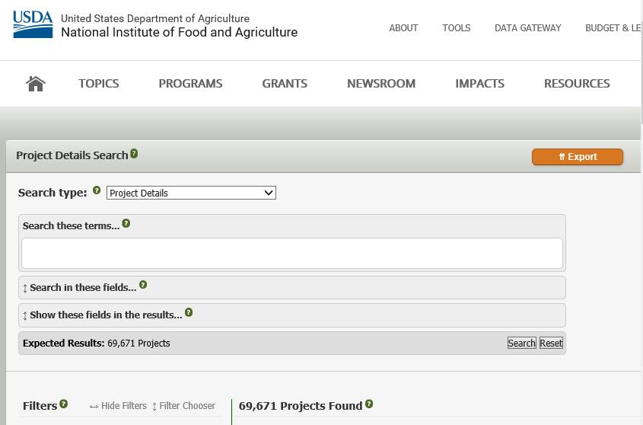

Slide 40
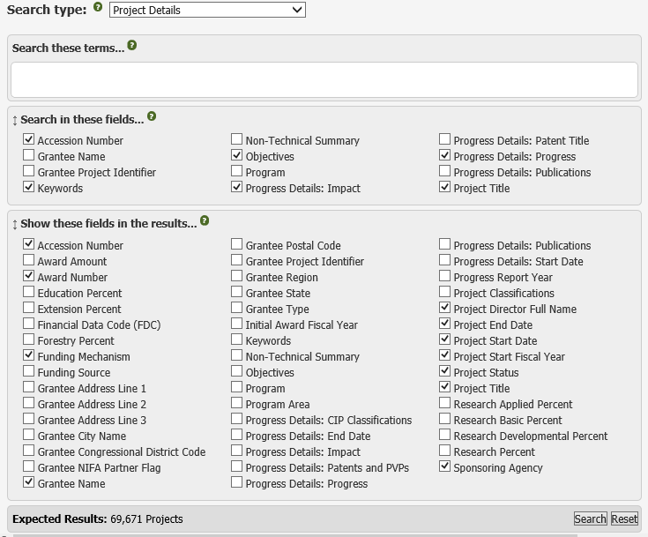

Slide 41
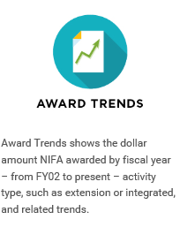
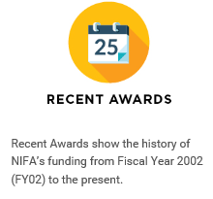
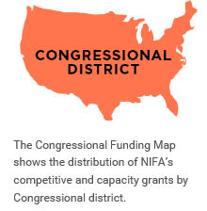
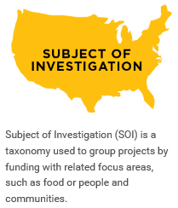
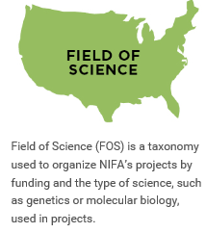
Notes:
Scrolling to the bottom of the page and clicking on a subject icon opens the results in a new page. You can find a listing of awards under Recent Awards, The Congressional District Map is currently being updated to include….. Award Trends shows total NIFA funding by Activity (extension, research, integrated). There are 3 other canned reports that show the amount of funding by KA, SOI, and FS by State.
projects information for that page topic, in the same format as the Leadership Management Dashboard (LMD).

Slide 42
Site Visits/Desk Audits and T&E Reporting Requirements (CFR 200.430)
Policy and Oversight Division

Slide 43
Site Visit/Desk Audit Objectives
NIFA site visits/desk audits fulfill requirements of the Improper Payments Information Act of 2002 (IPIA).
Office of Management and Budget (OMB) defines an Improper Payment as a
Payment that should not have been made or made in an incorrect amount
Payment for goods or services not received
Financial transactions with insufficient or missing documentation
The entire amount of an unsupported transaction is considered improper.
To meet the objectives, NIFA performs a comprehensive review of financial activity and project performance.

Slide 44
Selection Process
NIFA’s POD conducts 6 audits annually
3 Site Visits
3 Desk Audits
Factors in the selection process include
No previous NIFA audits
Amount of annual funding
Request from a National Program Leader or Awards Management Division
Significant/unresolved A-133 audit findings
OIG Hotline Complaint

Slide 45
Site Visit vs. Desk Audit
Site Visits/Desk Audits are performed in 2 phases:
Generally, 5-6 awards are selected for the review.
Phase 1 – review of written policies/procedures, and General Ledger (GL) details.
Phase 2 – review of document support for select GL details.
Desk Audits
Documents and GL details are sent/emailed to NIFA headquarters.
Program performance is evaluated through Accomplishment Reports/NPL input.
Site Visits
Site visit consists primarily of meetings with key personnel, PDs and facility touring.
Majority of document support is reviewed back at headquarters.
Great opportunity for grantees to showcase the great work being done with USDA/NIFA funding!

Slide 46
T&E Reporting Requirements
§ 200.430 (i) Standards for documentation
Key Points:
Salary/wage charges must be based on records that accurately reflect the work performed.
T&E reporting must be supported by a system of internal controls that provide reasonable assurance that charges are
accurate,
allowable, and
properly allocated.
Grant charges must reasonably reflect the total activity for which the employee is compensated, and not exceed 100% of compensated activities.
Best Practices Recommendations:
Review policies/procedures and update as necessary. Guidance places greater emphasis on strong internal controls
Salaries/wage allocations must be based on actual hours worked.
Interim budget allocations are permissible, but the internal control process should include a periodic review/comparison of actual hours worked vs. hours allocated.
If actual time worked differs from allocations, adjustments should be made to the amounts charged to the grant.

Slide 47
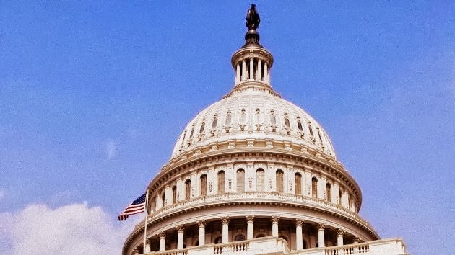
Update on Farm Bill Implementation

Slide 48
Farm Bill Update
Centers of Excellence
Summarizing stakeholder input from summer outreach efforts/webinars
Analyzing 1st yr. data/awards with COE designations
Providing applicant resources on NIFA website

Slide 49
Competitive Grant Programs Offering COE Opportunities in FY15 and FY16
Agriculture and Food Research Initiative – Challenge Areas | Farm Business Management and Benchmarking
Agriculture and Food Research Initiative – Foundational Program | Farm Safety and Youth Farm Safety Education and Certification
Aquaculture Research | Methyl Bromide Transition
Biomass Research and Development Initiative | Organic Agriculture Research and Extension Initiative
Biotechnology Risk Assessment Research Grants Program | Organic Transition Program
Children, Youth, and Families at Risk | Rural Health and Safety Program
Crop Protection/Pest Management | Specialty Crop Research Initiative

Slide 50
Farm Bill Update
Commodity Board Topics for AFRI FY16 RFAs (Fall/Winter Release)
18 topics received from boards, evaluated
Total of $4.8 million co-funding proposed
Working with boards to refine, finalize co-funding agreements
For co-funding, applicants must provide letter of support from sponsoring board

Slide 51
Update – FY16 Budget

Slide 52
Update – FY 2016 Budget
Continuing Resolution until Dec. 11 funds NIFA programs at FY15 levels
FY16 funding for mandatory programs subject to reductions due to sequestration

Slide 53
Erin Daly
Policy Advisor
Office of Grants &Financial Management
202 401 3319
edaly@nifa.usda.gov

Slide 54
Questions?
Awards- FormulaGrantFormsnifa.usda.gov
Grants Modernization - GrantsMod@nifa.usda.gov
LMD- electronic@nifa.usda.gov
Policy- Policy@nifa.usda.gov
ReePort- Electronic@nifa.usda.gov
Pratima Boyapati- Pboyapati@nifa.usda.gov
Mary Britt- Mary.A.Britt@nifa.usda.gov
Erin Daly EDaly@nifa.usda.gov
Laurie Fortis- Lfortis@nifa.usda.gov
Melanie Krizmanich- Mkrizmanich@nifa.usda.gov
Cynthia Montgomery- Cmontgomery@nifa.usda.gov
Allison Owens- AOwens@nifa.usda.gov
Lisa Scott-Morring- Lisa.Scott-Morring@nifa.usda.gov
Katelyn Sellers- KSellers@nifa.usda.gov

Slide 55
Thank you!

